Slide 1
The Failure of the Basic Reproductive Number
Gwangwoo Kim
Feb. 3, 2023

Slide 2
Basic Reproductive Number
For each generation of infected individuals, the simple average of the number of infections generated by each member of the cohort.
(Example) one case was a tourist who infected his spouse and the other was a doctor who infected eight people. R=4.5.

Slide 3
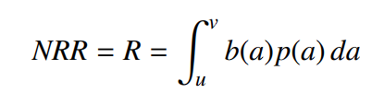
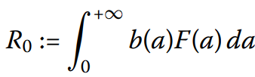
The survival function
Net reproduction rate (NRR)
The survival function
These data usually do not exist

Slide 4
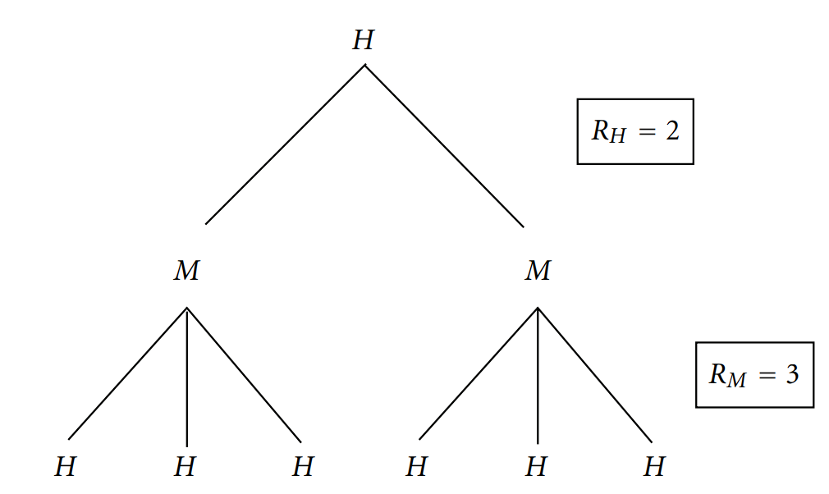
The survival function
a human infected at time 0 exists at time t
the probability that
a human infected for total time t infects a mosquito
an infected mosquito lives to be age a-t

Slide 5
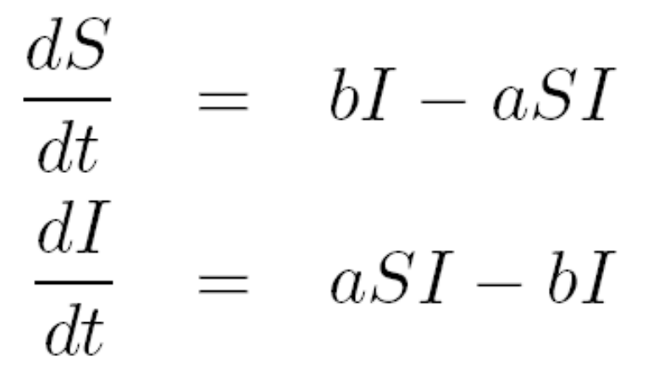
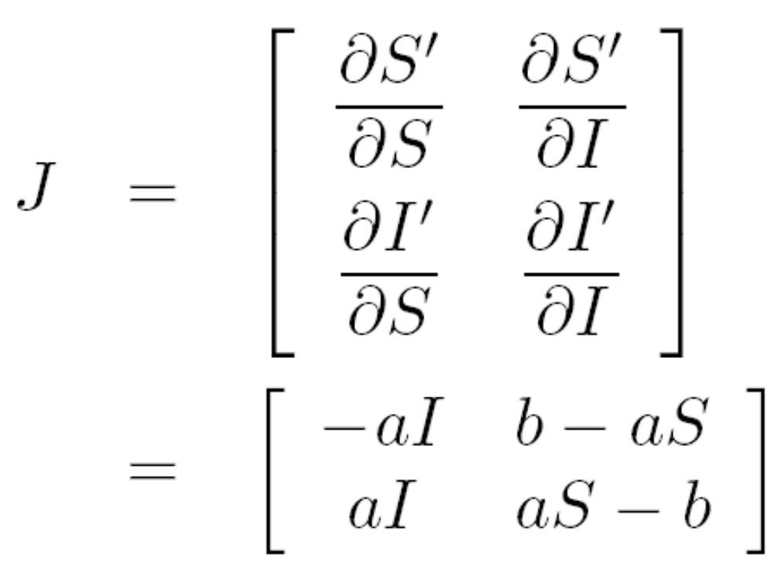
The Jacobian matrix
Suppose there is a (nonlinear) system of differential equations.
(Example) SIS Model
(Step 1) Create the Jacobian matrix

Slide 6
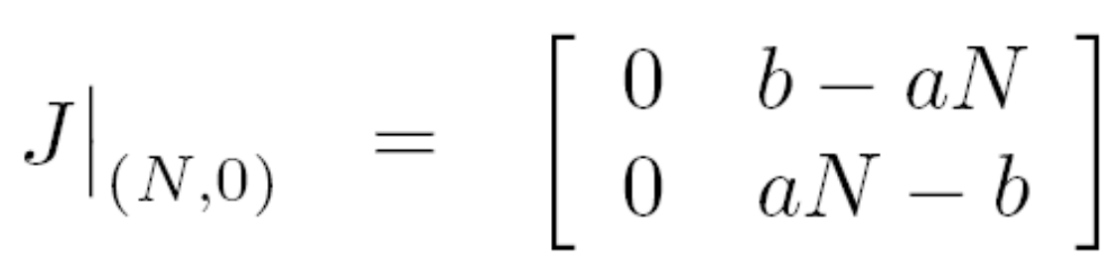
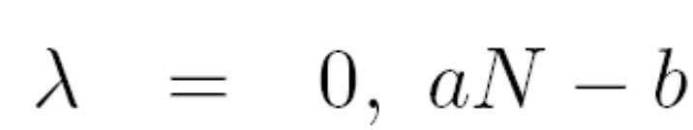
The Jacobian matrix
(Step 2) Evaluate the Jacobian at the equilibrium
(Step 3) Find the eigenvalues

Slide 7
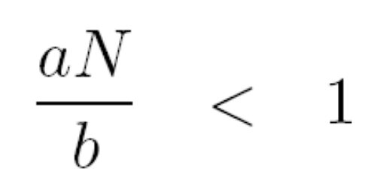
The Jacobian matrix
(Step 4) stable = Largest eigenvalue (real part) < 0
aN-b < 0 (⬄)
Note: The definition is depending on the model (SIS)
And, there's no reason the largest eigenvalue would inexorably lead to the average number of secondary infections. Therefore, the definition is not unique.
It can be defined only for ODEs.

Slide 8

The next generation method
(Set-up) The whole population is divided into n compartments in which there are m < n infected compartments.
Let xi be the number of infected individuals in the i th infected compartment at time t.
F = the rate of appearance of new infections in compartment i
V = the rate of transfer of individuals out of compartment i

Slide 9
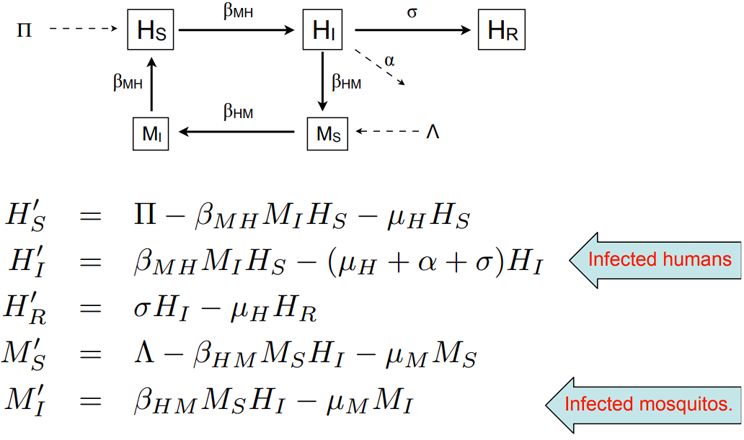
The next generation method

Slide 10
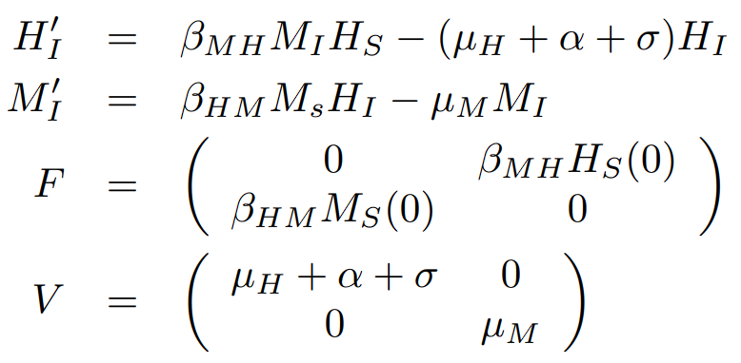
The next generation method
The matrix FV^-1 is known as the next-generation matrix. The largest modulus of the eigenvalues or spectral radius of the matrix is the basic reproduction number of the model.

Slide 11
The next generation method
The decomposition is not unique.
It is not clear that the value is indeed the average number of secondary infections.
In some cases, it is questionable whether this is biologically meaningful.

Slide 12
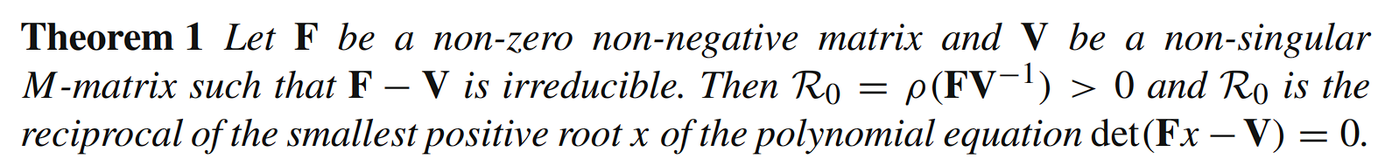
The graph-theoretic method

Slide 13
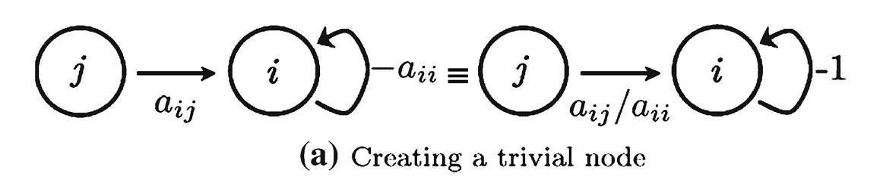
The graph-theoretic method

Slide 14
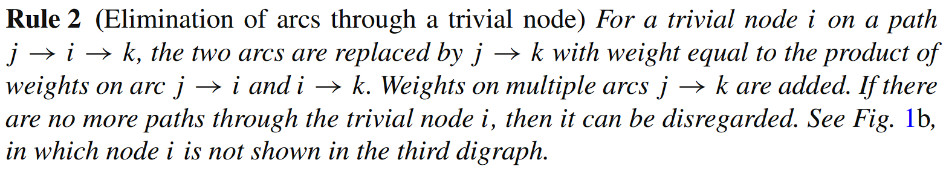
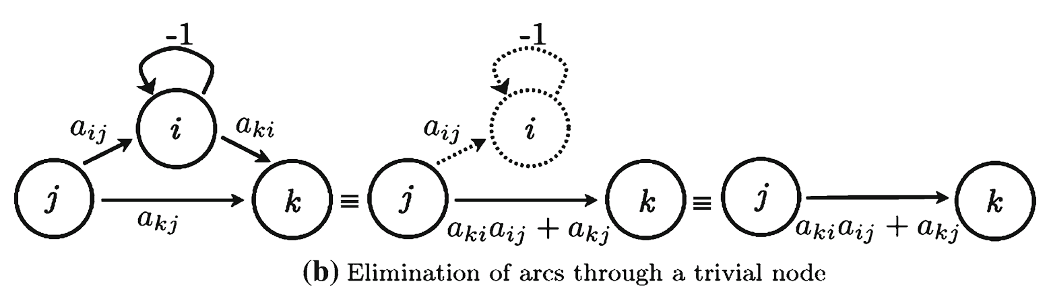
The graph-theoretic method

Slide 15
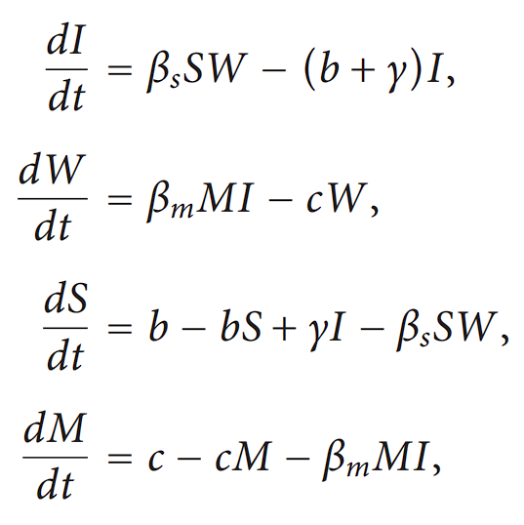
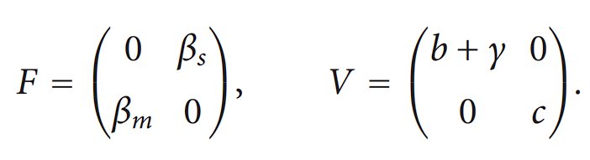
The graph-theoretic method
The disease-free equilibrium is (0,0,1,1)

Slide 16
